Slide 1

Forecasting McDonald's Quarterly Revenue

Slide 2
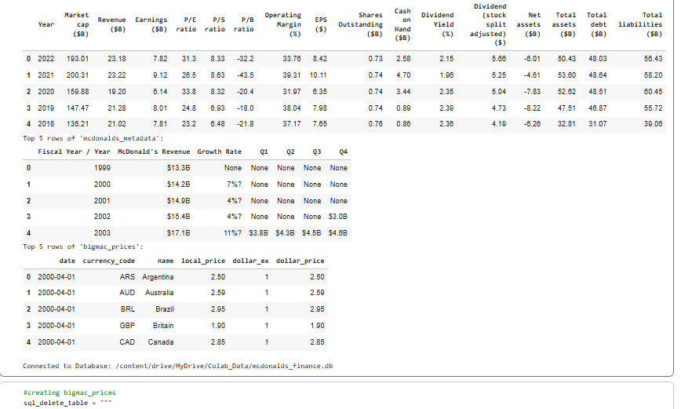
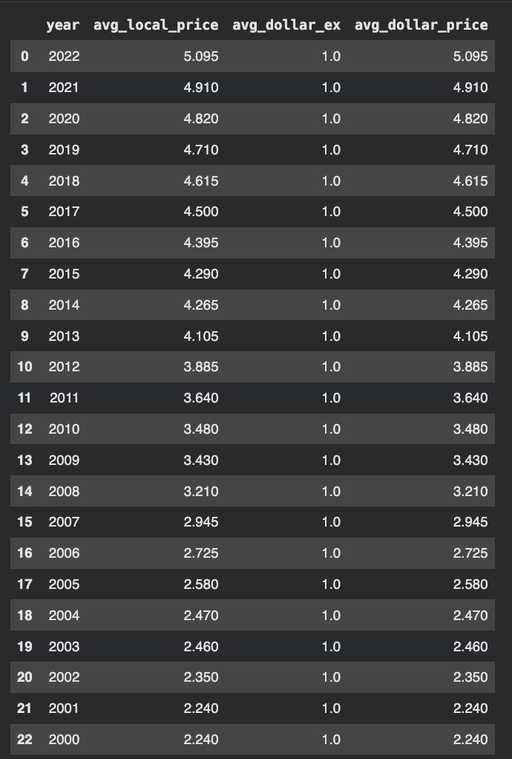
Cleaned McDonald's Financial Datasets
Transformed string values into REAL data types
  Got rid of non-numeric values
  Casted everything to make it numeric
Filtered Year to not include 2002 (data missing for that year)
Verified everything was good via SELECT statement
Cleaned & standardized Big Mac dataset
Filtered dataset to only include US prices and extracted the year from full date string.
Extracted year from date string
We aggregated using GROUP BY and AVG to produce one representative value per year
  Ensured the data was consistent prior to merging

Slide 3
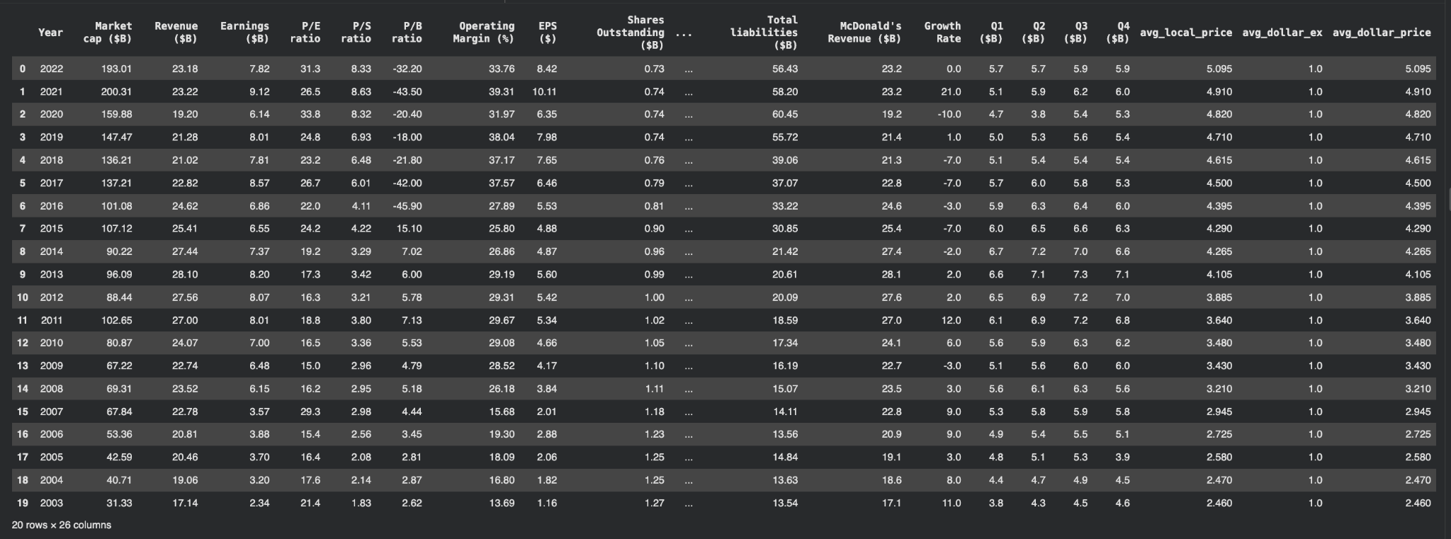
Merged Datasets
Performed left joins on the Year attribute to consolidate the datasets.
Replaced non numeric values; converted strings to real numbers.
Standardized units to billions.
The final cleaned table was exported to a DataFrame and saved as a CSV for use in modeling. This completed the database pipeline that supports both data quality and model readiness.

Slide 4
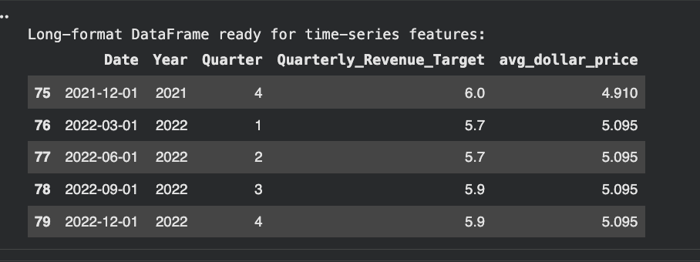
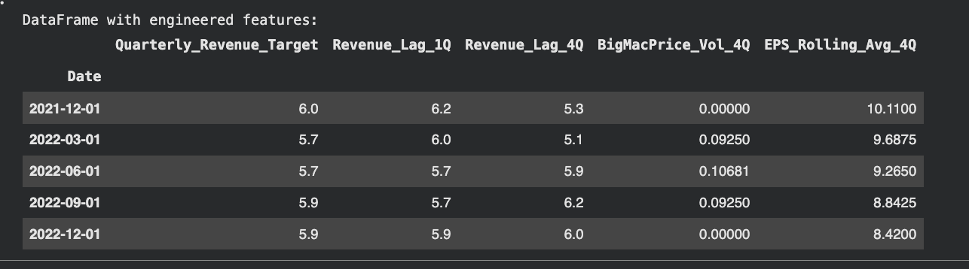
Preparing Data
Transformed DataFrame from a wide format to a long format and prepare it for time-series analysis
Perform Feature Engineering on time-series df
  Create new predictive variables that capture temporal relationships + rolling statistics
  Preparing data for predictive model

Slide 5
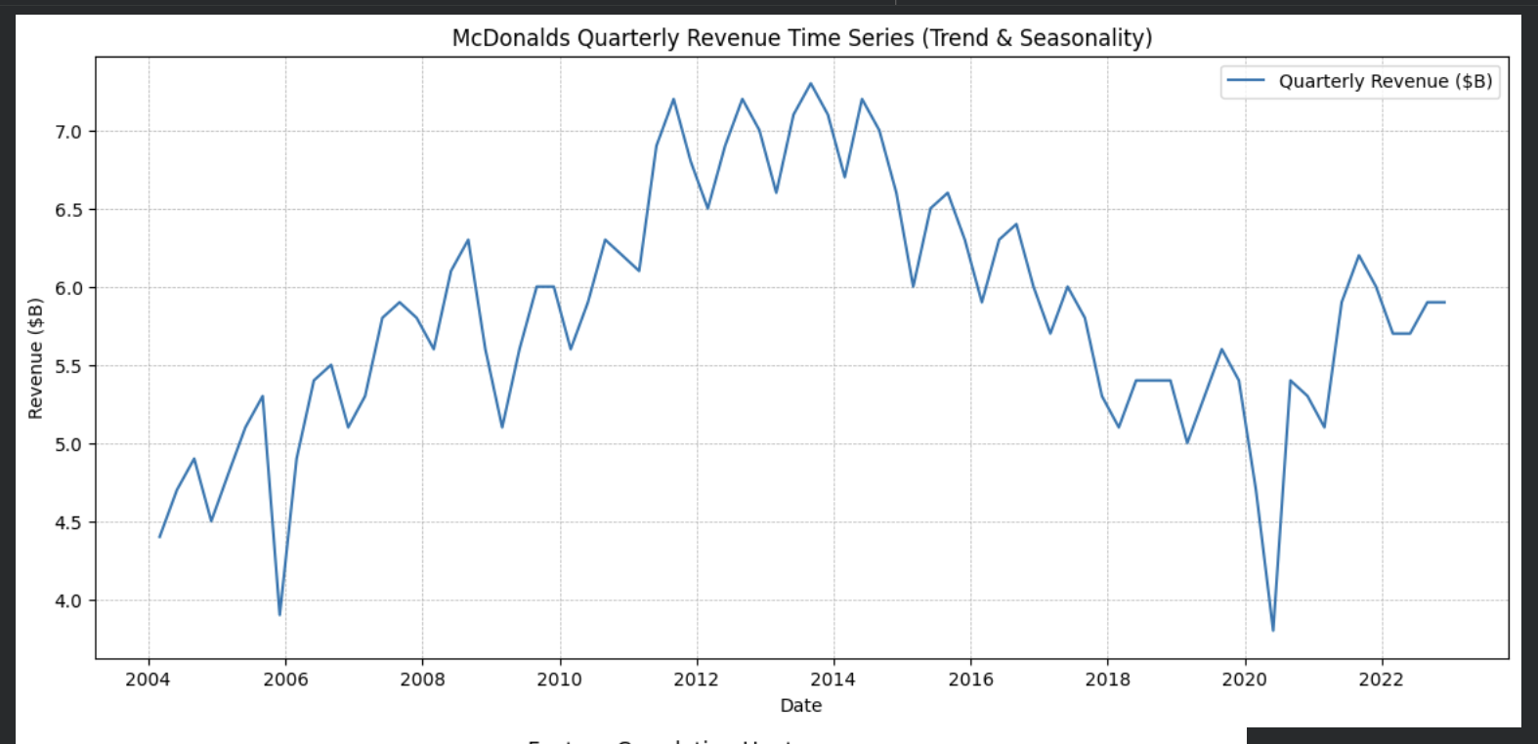
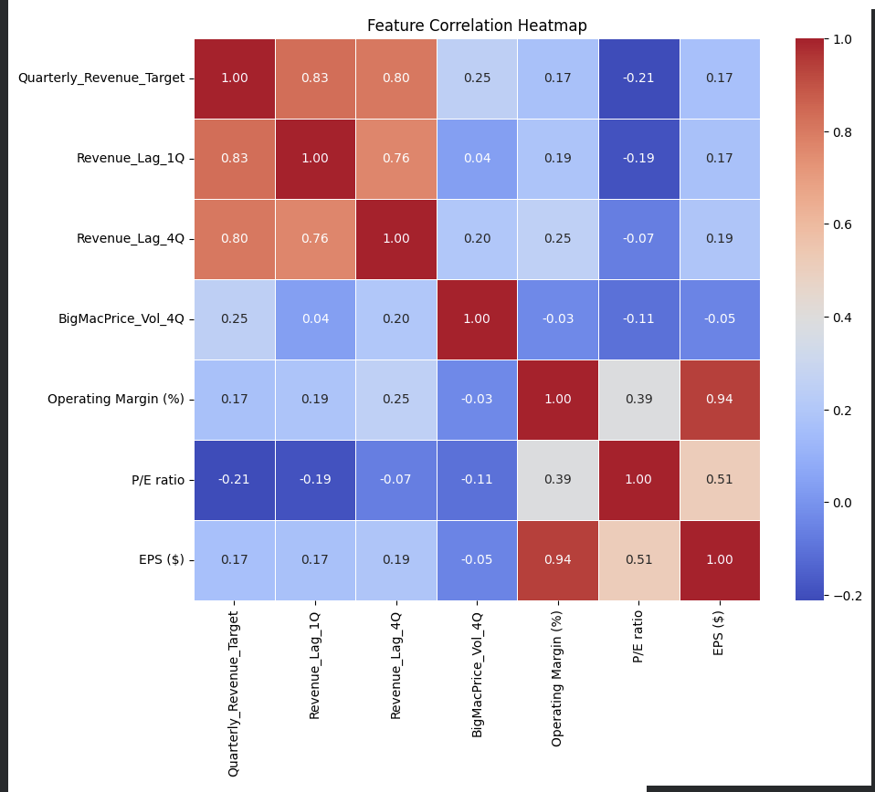
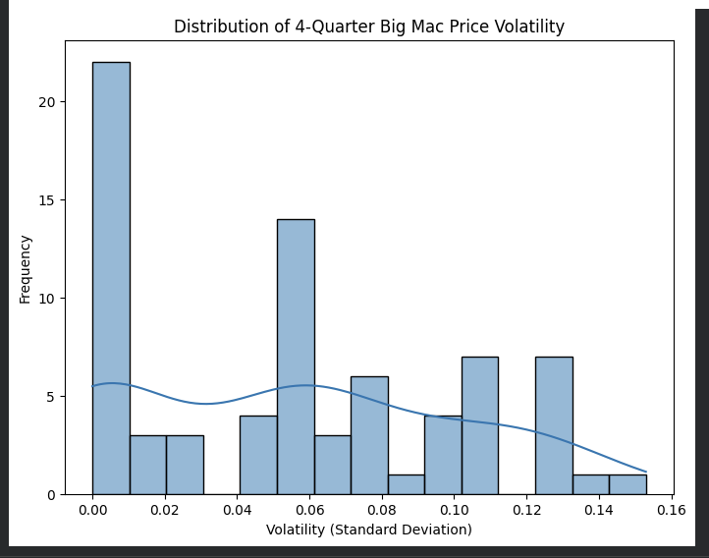
Exploratory Data Analysis
Time series shows upward trend from 2004 to 2014 followed by decline & stabilization until 2018
Strong seasonal pattern
  recurring peaks and troughs within each year
Sharpest single drop in 2020 (likely Q2)
  Corresponds to the initial impact of pandemic
Following 2020 low point, revenue showed strong, rapid recovery & rebound in the subsequent years
Lagged revenue features (Revenue_Lag_1Q at 0.83 and Revenue_Lag_4Q at 0.80) are strongest predictors of the Quarterly_Revenue_Target
Traditional financial metrics like EPS ($) & Operating Margin (%) show weak positive correlations (0.17) with target revenue
The BigMacPrice_Vol_4Q feature has weak positive correlation of 0.25, indicating minor predictive value.
Strong correlation of 0.94 exists between Operating Margin (%) and EPS ($), suggesting high multicollinearity
Distribution of 4-Quarter Big Mac Price Volatility is heavily right-skewed,
High frequency of values close to 0.00 indicates Big Mac price is generally stable over one-year period

Slide 6
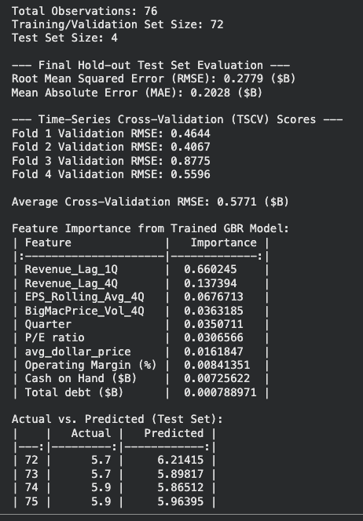
Gradient Boosting Model
Primary goal: train & evaluate Gradient Boosting Regressor (GBR) model for predicting McDonald's quarterly revenue
Validated model's performance using final hold-out test set & Time-Series Cross-Validation (TSCV).
Initial steps : cleaning string data, converting quarterly data from wide to long and creating proper time-series index.
Time-series features were engineered, including 1-Quarter and 4-Quarter revenue lags & 4-Quarter rolling stats
Dataset was split into large training/validation set and final 4-quarter hold-out test set
Final hold-out test set showed high level of accuracy
  Root Mean Squared Error: $0.2779 Billion
  Mean Absolute Error: $0.2028 Billion
Average Cross-Validation RMSE: $0.5771 Billion was higher than the test RMSE
  Suggests better performance on most recent, unseen data
Revenue_Lag_1Q (0.66) was identified as most important feature
Other financial and economic features weren’t as heavy contributors to prediction power

Slide 7
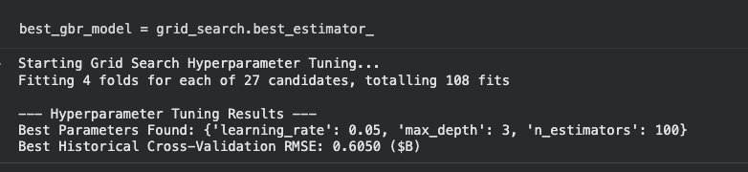
GBR Hyperparameter Tuning
Primary goal: Optimize Gradient Boosting Regressor (GBR) model's hyperparameters
  Used Grid Search & Time-Series Cross-Validation (TSCV).
Tuning process explored 27 candidate parameter comos across 4 time-series folds; totaled 108 model fits
Best parameters : {'learning_rate': 0.05, 'max_depth': 3, 'n_estimators': 100}
Best Historical Cross-Validation RMSE: $0.6050$ Billion

Slide 8
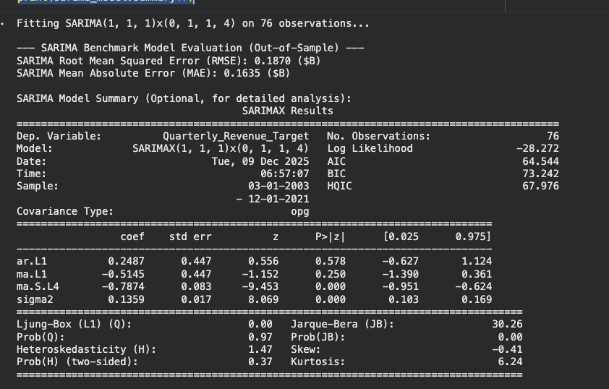

SARIMA Benchmark Modeling + Final Model Comparison
Aim: fit SARIMAX model to revenue target as statistical benchmark
  Model: SARIMA(1, 1, 1)x(0, 1, 1, 4)
  Aim: capture both autoregressive & seasonal (4-quarter) components of time series
  trained on training data & evaluated on same 4-quarter hold-out test set
Out of Sample Test Results:
  Root Mean Squared Error: $0.1870 Billion
  Mean Absolute Error: $0.1635 Billion
Final Model Comparison:
  Compare performance of GBR model against SARIMA benchmark:
  GBR model:
    RMSE: $0.2779 Billion
  SARIMA model:
    RMSE: $0.1870 Billion.
Conclusion: SARIMA model provided significantly better short-term forecasting accuracy on test set. The SARIMA model sets a very high benchmark, which proves that the internal historical structure of McDonald’s revenue is currently the most reliable predictor of its future value.

Slide 9
SARIMA Benchmark Modeling + Final Model Comparison
This means that the SARIMA model achieved a lower forecasting error than our gradient boosting model on the 4 quarter hold out set. Its average forecast error was $187 million, which beat the GBR’s $278 million error.
Metric | SARIMA Result | GBR Result | Comparison
RMSE | 0.1870 | 0.2779 | SARIMA performs better on this test set
MAE | 0.1635 | 0.2028 | SARIMA performs better on this test set
SARIMA model provided significantly better short-term forecasting accuracy on test set. The SARIMA model sets a very high benchmark, which proves that the internal historical structure of McDonald’s revenue is currently the most reliable predictor of its future value.

Slide 10
Proposed Deployment
Source and Database:
Source: This is where the CSV files are kept, securely stored in a place like Google Cloud Storage. We pull the latest quarterly data from here.
Database (PostgreSQL): This is where we store the final, official forecast results. Instead of looking through old spreadsheets, anyone who needs the forecast just asks the database.
Apache Airflow:
This is the scheduling tool that ensures every step runs correctly, in the right order, and on time.
Schedule: For example, you tell the airflow: “Run the entire forecast process every three months (quarterly). Airflow then wakes up automatically on that schedule.
Pipeline: airflow follows a strict “to-do” list (DAG):
Get the latest data and run the ETL and clean the code.
Feed the cleaned data into two main prediction machines: the GBR model and the SARIMA model.
Take the final predicted revenue numbers and save them securely into the database.
We propose a four-stage MLOps Pipeline which is designed to run reliably every quarter. Think of this architecture as a fully automated, quarterly forecast factory that runs itself without needing you to manually click "Run" every time.

Slide 11
Proposed Deployment (cont’d)
Model Execution:
The code cleans up the data and prepares the specific features needed for the GBR model.
The GBR and SARIMA scripts run the forecast for the next 4 quarters. This makes sure that the prediction logic is exactly the same every time.
The Server (Flask API):
This provides a simple way for other applications to get the results instantly. Instead of accessing the database directly, another program sends a simple request (i.e. what is the Q1 revenue forecast?) to the Flask API. The API quickly checks the database, grabs the latest GBR and SARIMA forecasts, and sends them back immediately in a clean, standardized format.
Overall, this system would allow us to get a forecast that is fresh, reliable and easy to access by the business every quarter.
We propose a four-stage MLOps Pipeline which is designed to run reliably every quarter. Think of this architecture as a fully automated, quarterly forecast factory that runs itself without needing you to manually click "Run" every time.

